Slide 1
LPDDR4 and IMX8MP
What is LPDDR Training?
Do we need them?
Hardware requirement?
Note: IMX8MP does not support LPDDR4X only LPDDR4(!).
19 Aug 2024: Riscy / CK. Emerson

Slide 2
What is DDR Training Session?
Training session is a procedure to process calibration that aims to improve signal performance between CPU and DRAM interface and mitigate spurious bits errors.
There are several type of training session:
ZQ: Impedance matching (to match layout impedance)
DQ: Data quality matching (timing calibration between CLK and DATA)
This balance the tset and thold timing.
Signal level (which varies with temperature)
…..and few others.
Why it is more relevant now?
We operating to highest clock frequency between CPU and DRAM which lead to higher risk of spurious bits errors. It rely on serial data clocking at 1600MHz (2166MHz max). It clock data at rising and falling edge (double data rate)
Training procedure performs calibration to mitigate data error.

Slide 3
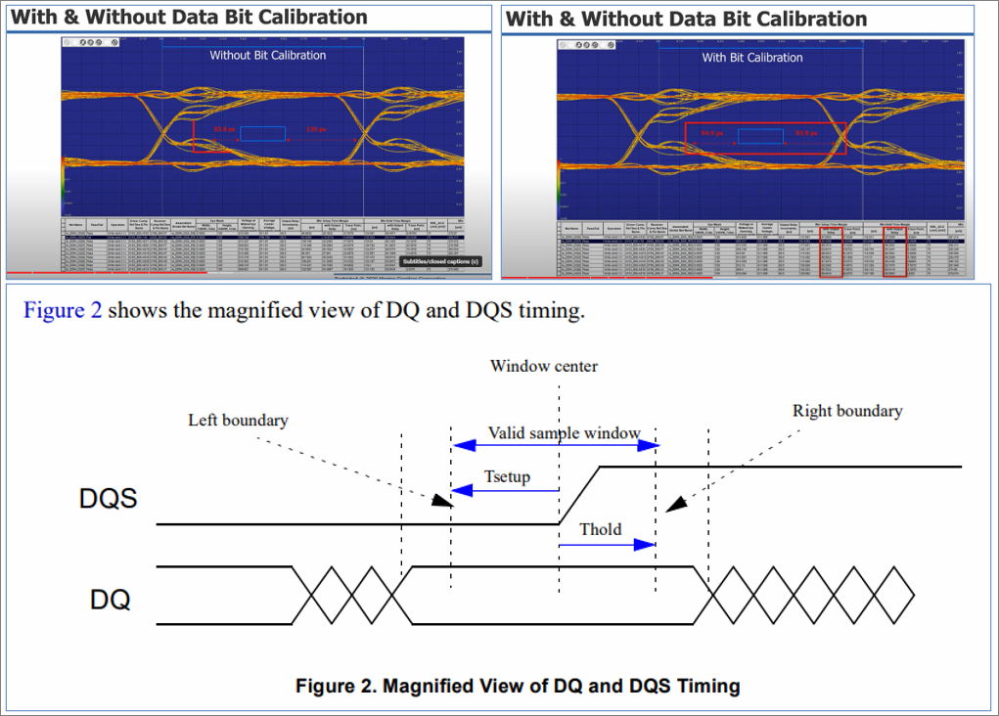

Slide 4
There two way to performs training
Automatic training within the LPDDR4 device
PRO: Convivence and build-in during power up procedure.
CON: Some LPDDR may not performs *all* training session.
More of the next slide
Manual training using NXP DDR Tools setup
PRO: Complete training session
CON: Learning curve and confidence.
CON: Requires debug interface for this software to run.
More of this next slide

Slide 5
Automatic LPDDR4 Training Session
LPDDR4 (Micron) has built in training interface and commands which address the following service (simplified details)
Impedance and terminator calibration (ZQ/ODT)
Data (timing) matching (DQ, DQS)… this is eye calibration (CLK and Data)
Read/Write Level optimisation (VREF, CA).
…few more but that details.
During power up, it check default training register that determine which training service to runs. According to Micron datasheet, it was found that
It automatically performs impedance matching calibration (ZQ).
It automatically performs Write/Read levelling with VREF calibration.
But it skipped the Data timing matching (DQ) which is default implementation.

Slide 6
Manual LPDDR4 Training Session
NXP DDR Tools is a Window based software that support manual full training session suite by taking control of LPDDR4 device IMX8M device.
Performs training once every LPDDR4 batch, ie do not need to perform this calibration every board, only few batches.
Do we do this procedure at PCB vendor or Emerson in-house? Is this common practice?
Learning curve is required to support this.
Requires hardware USB-OTG and USB-Debug (UART) interface. More of this in later slide.
JTAG is not required and advisory to avoid this approach unless we hire experts (cost $$$). JTAG may need boundary scan mode enabled.

Slide 7
Do we really need to do manual training?
CK has prior experience applying training session to obtain calibration parameter that was used to optimise DDR device during Power up.
We don’t know CT100 CPU project has done manual training session, before. They use IMX8MM (Mini) device, while we use IMX8MP (Plus).
We do know LPDDR4 (Micron) has built-in training session during power up but does not cover DQ parts.
With automated training that run on POR, was is sufficient to do away with manual training?
We do know this is only 1 LPDDR4 device next to IMX8MP with same or similar layout as EVAL board, can we get away with this?
How DDR calibrated parameter is stored and passed to LPDDR4 device during power up?
Arthur indicated we never have LPDDR4 issue in the past with CT100?

Slide 8
Difference between IMX8MM and IMX8MP
IMX8MM Max LPDDR4 clock is up to 1500MHz (CT100 MCU)
IMX8MP Max LPDDR4 clock is up to 2000MHz (The Next Gen MCU)
Quoted LPDDR4-4000 support in datasheet.
Micron (MT53E1G32D2) device is rated to max 2133MHz clock.
Question:
Can we avoid manual training if we limit clock to 1500MHz?

Slide 9
Safety Integrity Requirement to justify?
Is there safety requirement (ie standard?) for reliable product under hazardous environment to ensure proper mitigation of data error that may failed to trigger gas alarm (or generate fake signal)?
Is firmware doing any safety integrity level works?, if so have they factor to address defective data.
Is there redundancy arrangement in firmware to address defective data?

Slide 10
Hardware requirement
USB interface is purely for debug roles. There no real application use. CB made clear on this.
Originally Riscy has implemented USB-Device for simplest low-cost interface, however due to peer pressure. The design was change to USB-OTG with Host only power (based on CT100). Note: Device power is not supported but still operate as USB-OTG with Host or Device.
We keen to avoid USB-OTG solution from EVK due to additional (new) components. Superspeed interface is something we want to avoid under debug environment. CK has not determined CT100 is right solution for the job. We do know it used for firmware update, so it seem unlikely we need superspeed for that. Riscy is reviewing requirement for USB with CK with hope CT100 USB solution is sufficient.
To support USB-Debug (uD) for UART interface. Riscy propose to develop small adaptor board with FT4232H device (USB to JTAG and 3 x UART and IO interface). There is positive support for this solution.

